Slide 1

Smart customer care
Team Members
Ahmed Abbas
Fakhr Mahmoud
Mohamed Anwar
Karim Omar
Mohamed Refaie
Supervised by
Dr. Walaa Medhat
Eng. Ali Abdel Razik
1

Slide 2
TABLE OF CONTENTS
01
02
03
Introduction
Idea behind the project
Solution
04
05
Progress
References
06
Summary
2
2

Slide 3
Introduction
Customers nowadays don’t build their trust just on the price of product, but on the experience they receive.
Corporations compete to provide their customers an experience to remember.
Hence big corporations seek the most creative ways to filter customers’ opinions.
3

Slide 4

The idea behind the project
This project seeks to help corporations to improve their products & services by improving on customers’ opinions, a solution corporations are ready to pay for, but how do we do that?
4

Slide 5


Scrapping
Social Media
Websites
5

Slide 6


Apply
Natural Language
Processing
6

Slide 7

Our progress in the project
7

Slide 8
Working prototype
We used different web scraping frameworks and determined the best suitable for the project.
MongoDB, a NoSQL database was chosen to store our scraped data.
First, we scraped data
From news websites like BBC and The Guardian.
Performed NLP topic modelling on the scraped data.
8

Slide 9

Scrapy
Is an open-source and collaborative framework for extracting the data you need from websites.
EX. Trivago & Booking
9

Slide 10
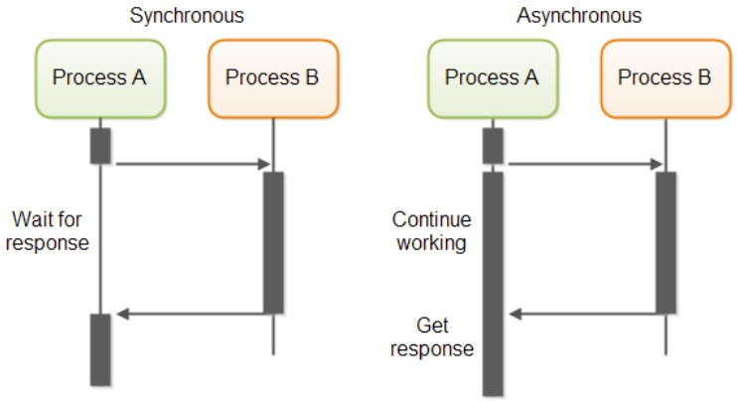
Why use Scrapy?
Given a start URL,
scrapy could crawl deeper.
One of the biggest advantages of Scrapy is speed.
Asynchronous networking framework.
10

Slide 11

Why use MongoDB
Schema-less design
Easily Accessible
No need for predefined structuring
Supports almost all the major programming languages
Fast
Easy to use
Queries and other operations are fast due to its basic structure
Does not need extensive knowledge to get started
11
4

Slide 12
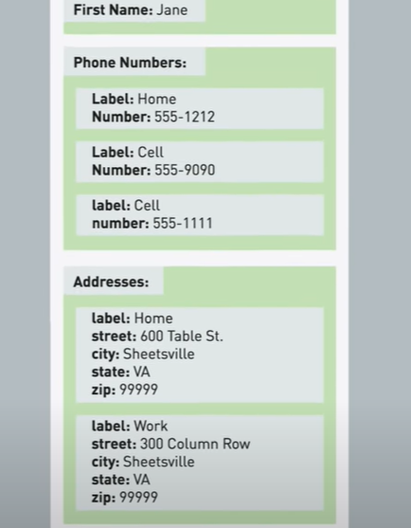
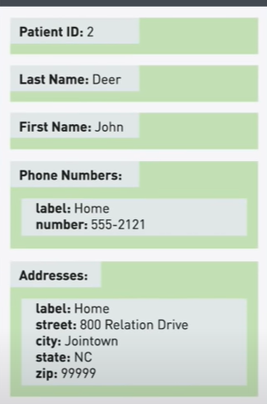
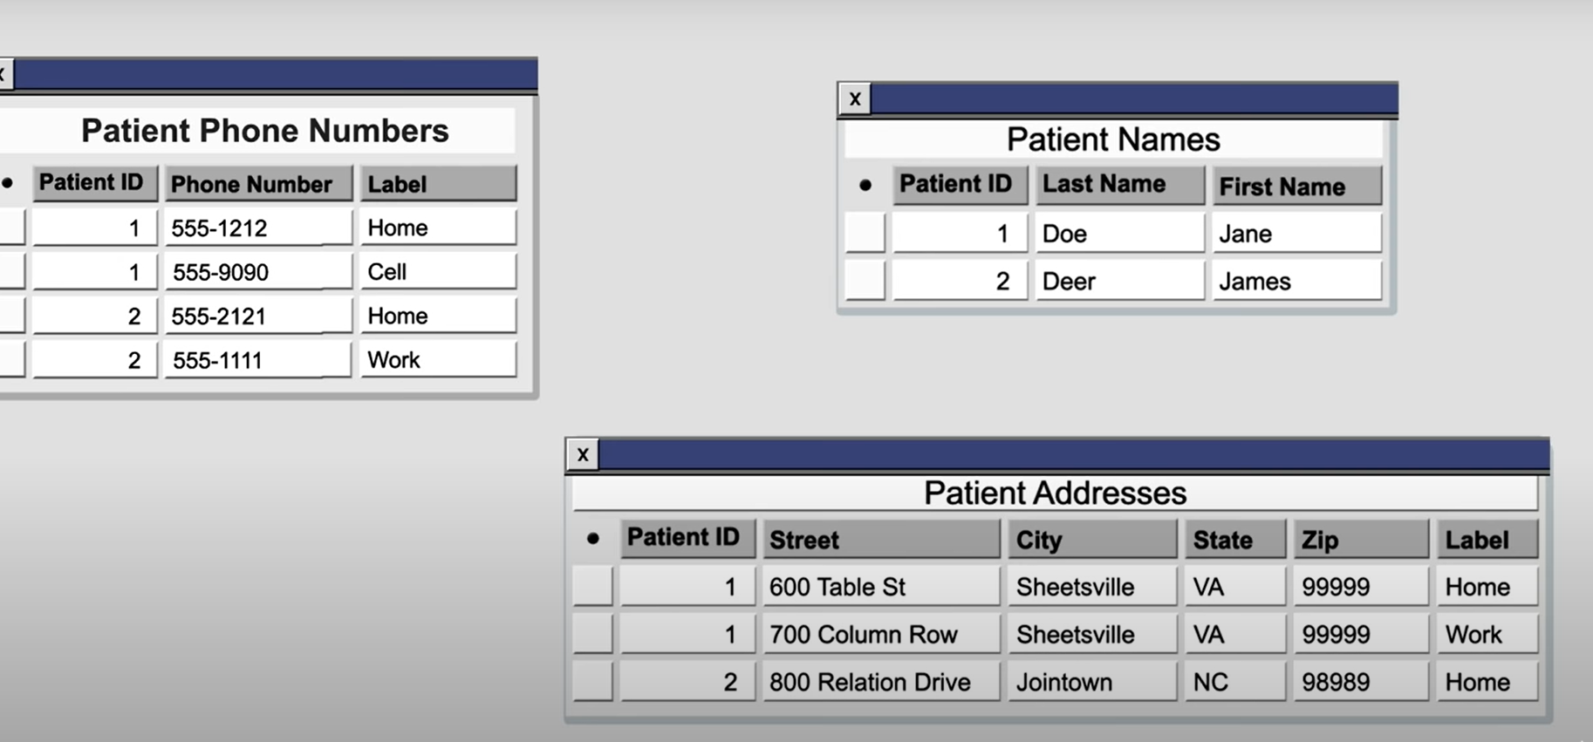
Relational Model
NoSQL Model
Database becomes complex and dependent on each other
Requires a planned predefined structure
Data is stored in tables called collections
Data is flexibly stored per document without the need to update the entire table
12
4

Slide 13
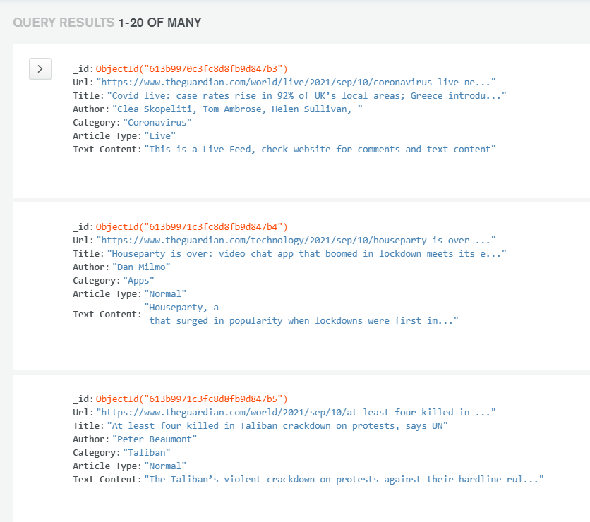
Why use MongoDB
Schema-less design
Easily Accessible
No need for predefined structuring
Supports almost all the major programming languages
Fast
Easy to use
Queries and other operations are fast due to its basic structure
Does not need extensive knowledge to get started
13
4

Slide 14


NLP using Gensim
Apply LDA topic modelling
Preprocessing
Prepare the data in a format supported by our model
Remove any unnecessary data
Distribute all related data and words into clusters from which a topic can be identified
14

Slide 15
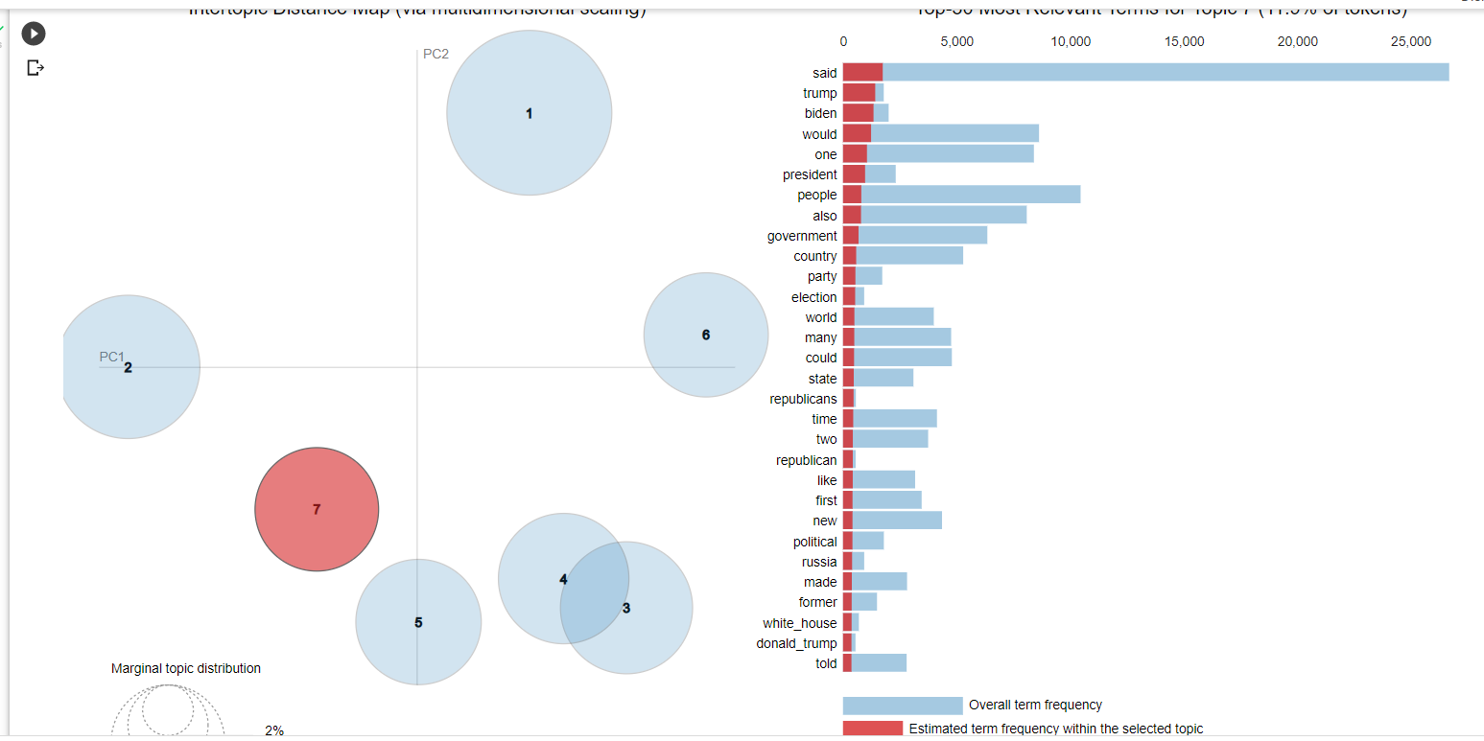
Topic Modelling
Seems like one of the topics compiled by the model is related to US politics
An example of one of the topics
15
4

Slide 16
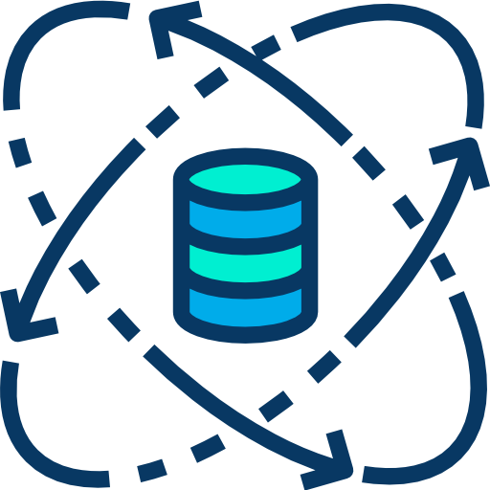
References
IBM Artificial Intelligence.
Build your Own Chatbot for Good.
Modern Web Scraping with Python using Scrapy.
MongoDB crash course.
developer.ibm.com/digitalnation/africa/course/innovator-chatbot-for-good/overview?
developer.ibm.com/digitalnation/africa/course/innovator-chatbot-for-good/overview?
udemy.com/course/web-scraping-in-python-using-scrapy-and-splash/
university.mongodb.com/courses/M001/about
radimrehurek.com/gensim/auto_examples/index.html
Gensim Documentation
16

Slide 17


Project Repositories
(Scraping) https://github.com/KarimBastami/Scrapy_News_Scraper
(Topic Modelling) https://colab.research.google.com/drive/1PEHwcG6ANbYES2PFX5NRFOoAOSUrCpOO?usp=sharing
GitHub
Google Collab
17

Slide 18

Summary
Customers build trust based on their experience
Building blocks includes:
Web Scraping news articles using Scrapy and Beautiful soup
Saving and Querying Scraped Data to MongoDB
NLP Topic modelling using Gensim
Scrapy is a fast, optimized and professional web scraper
MongoDB is a fast, schemeless and easy to use noSQL database
Data was preprocessed and used in topic modelling using Gensim
One of the identified topics was US Politics
18

Slide 19

19

